Slide 1
Cohort 1
Preinduction-W1-W2-W3 from left to right
From week 2 I also included the LDCT paradigm.

Slide 2
EPM

Slide 3
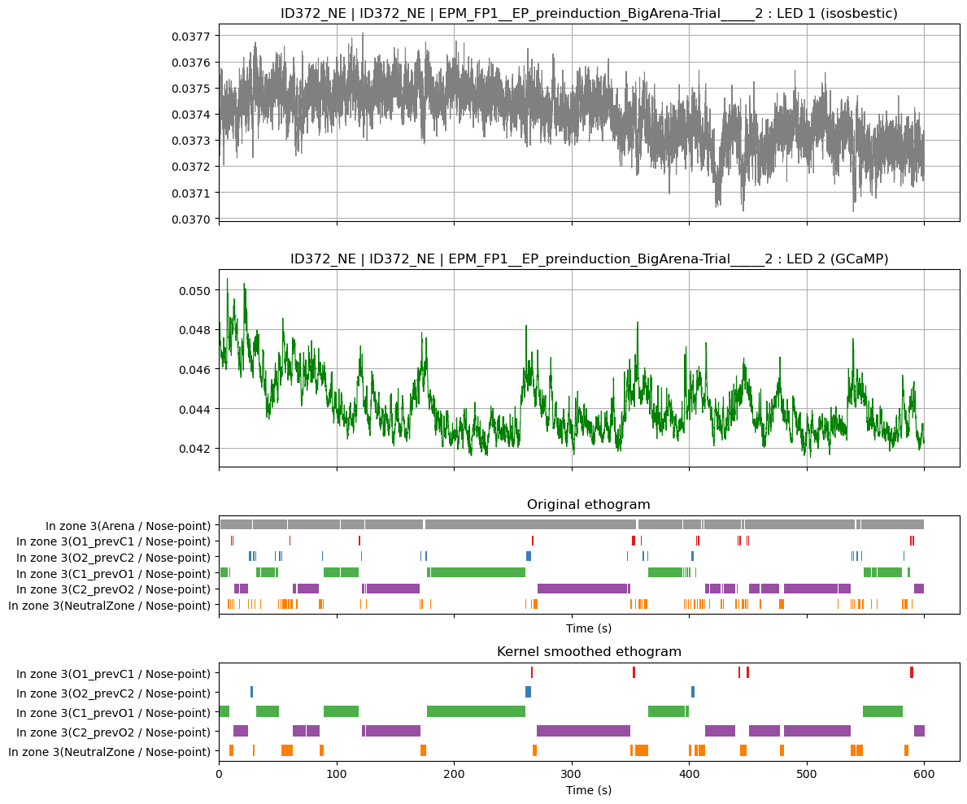
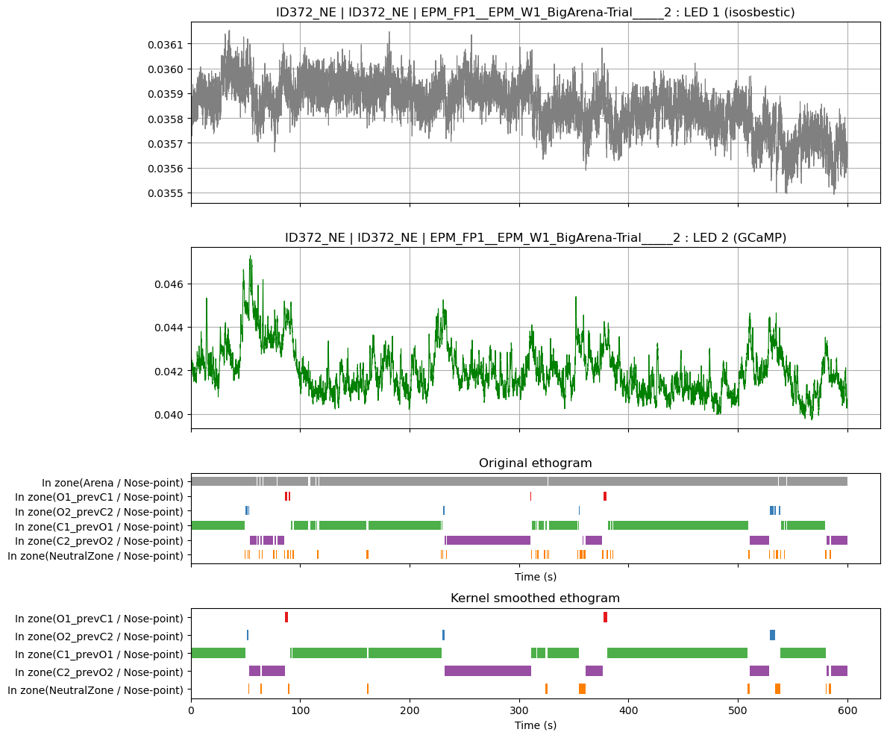
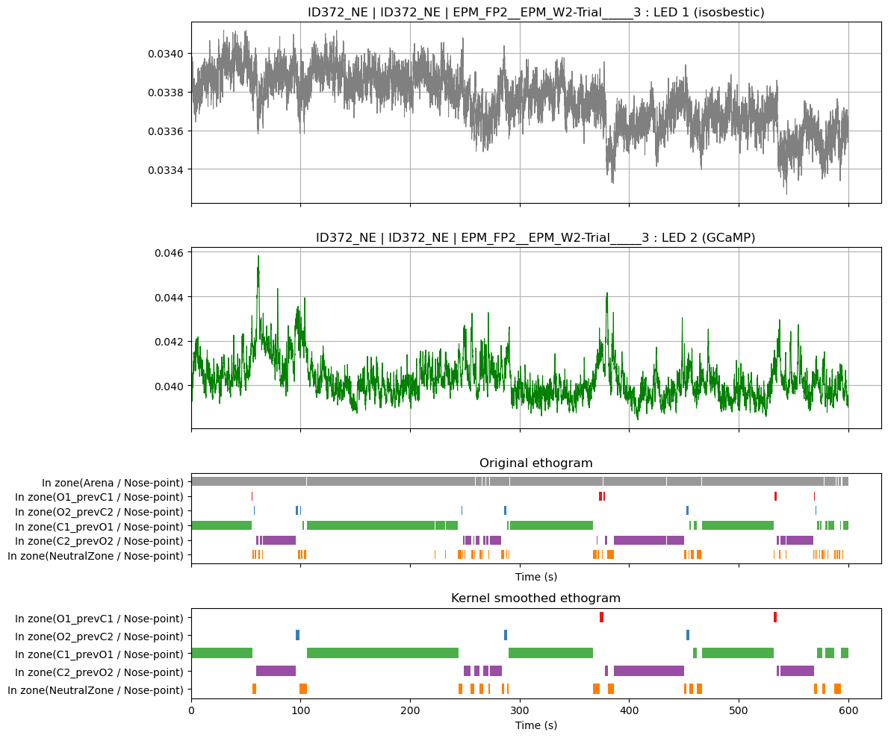
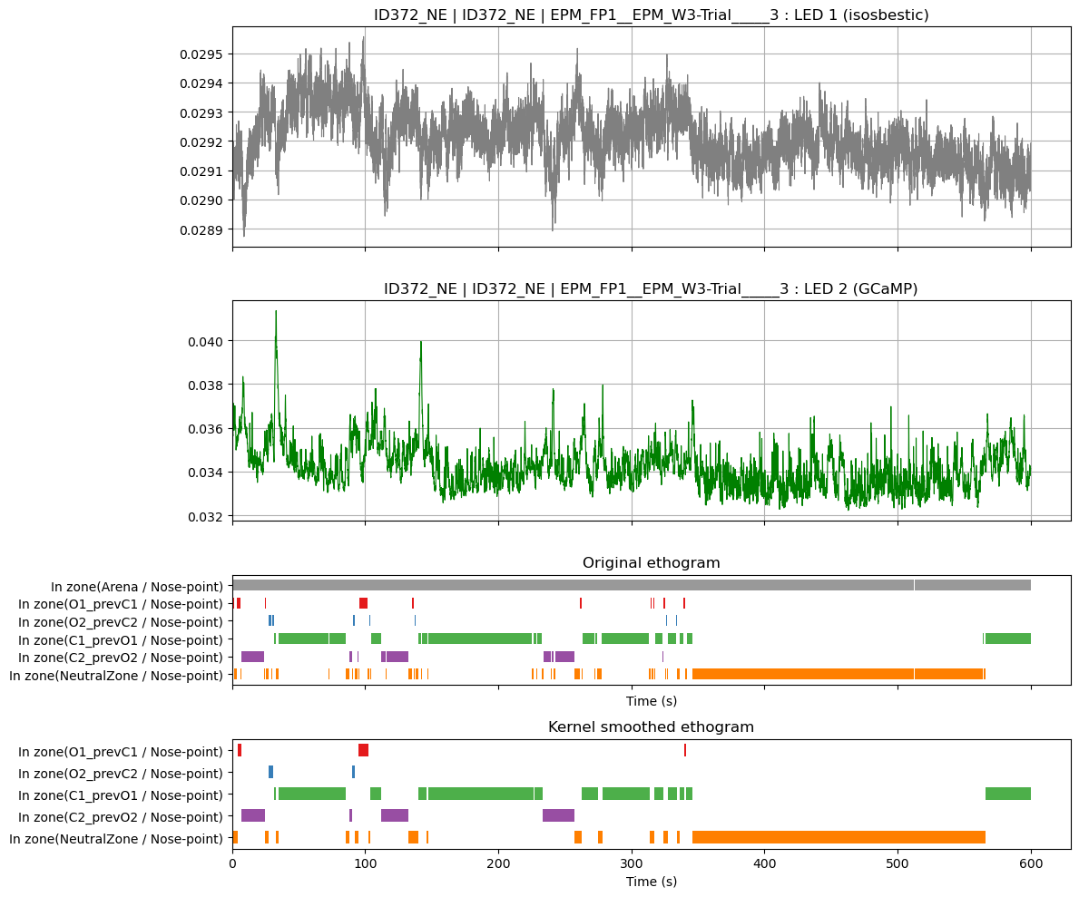
EPM – M372 – pretty stable at 0.4-.045 until W3 after introducing the LDCT at the last day of the previous week, then drops to .03

Slide 4
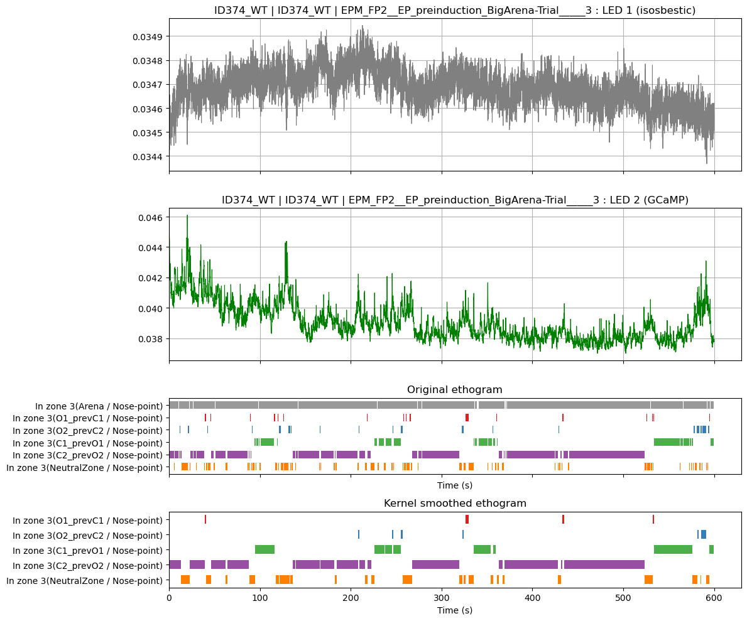
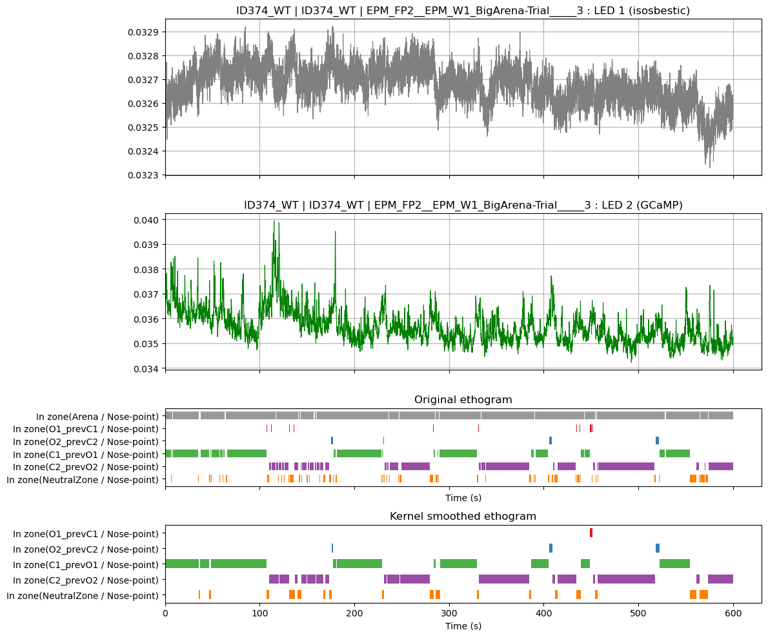
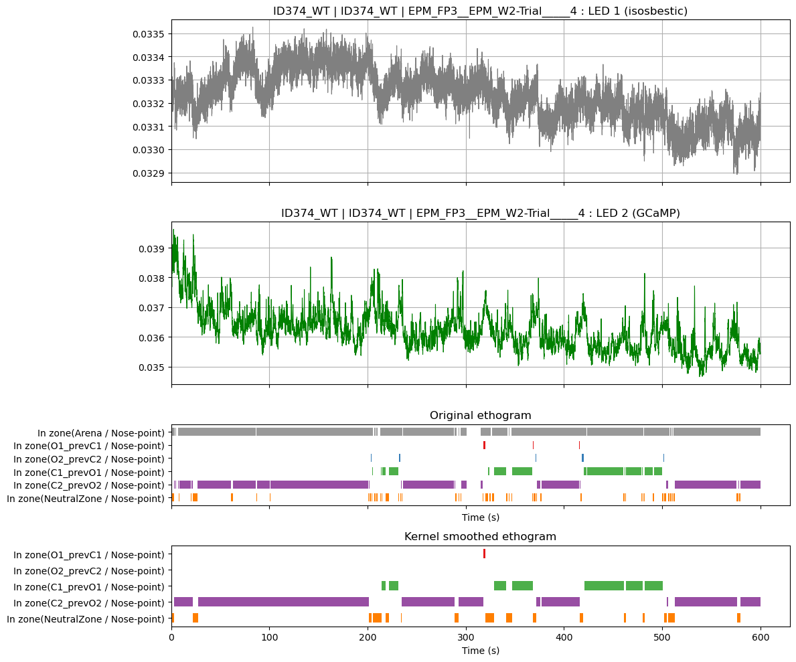
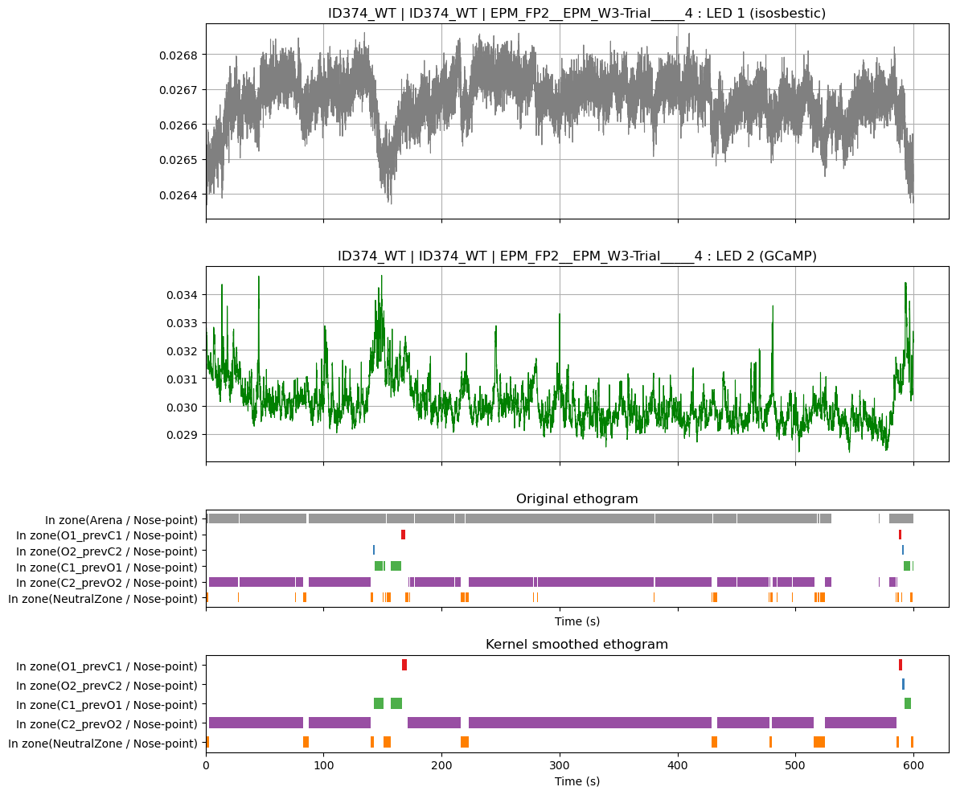
EPM – M374 – pretty stable around ~.035-.04 for first 3 weeks, then drops to 0.03 at week 4

Slide 5
LDCT

Slide 6
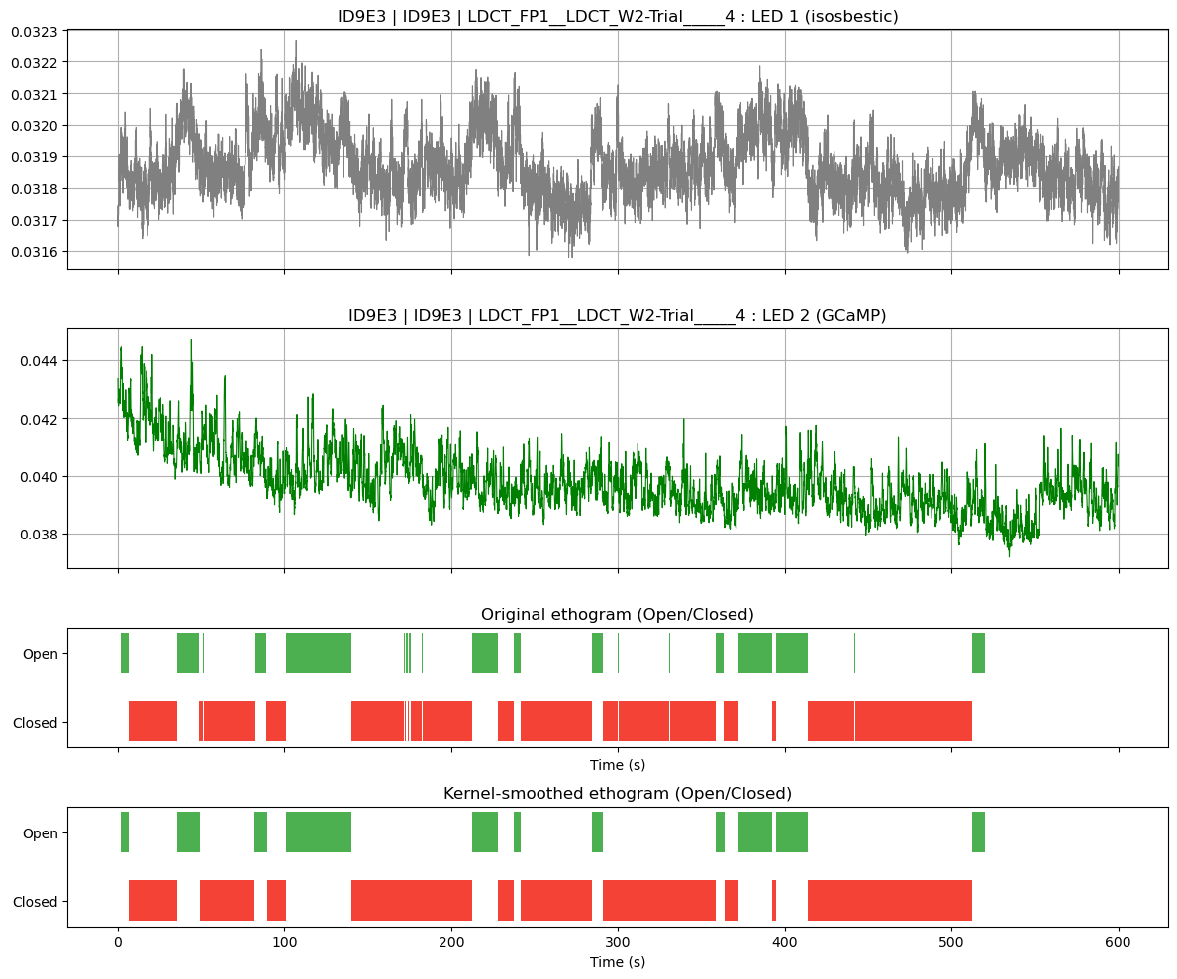
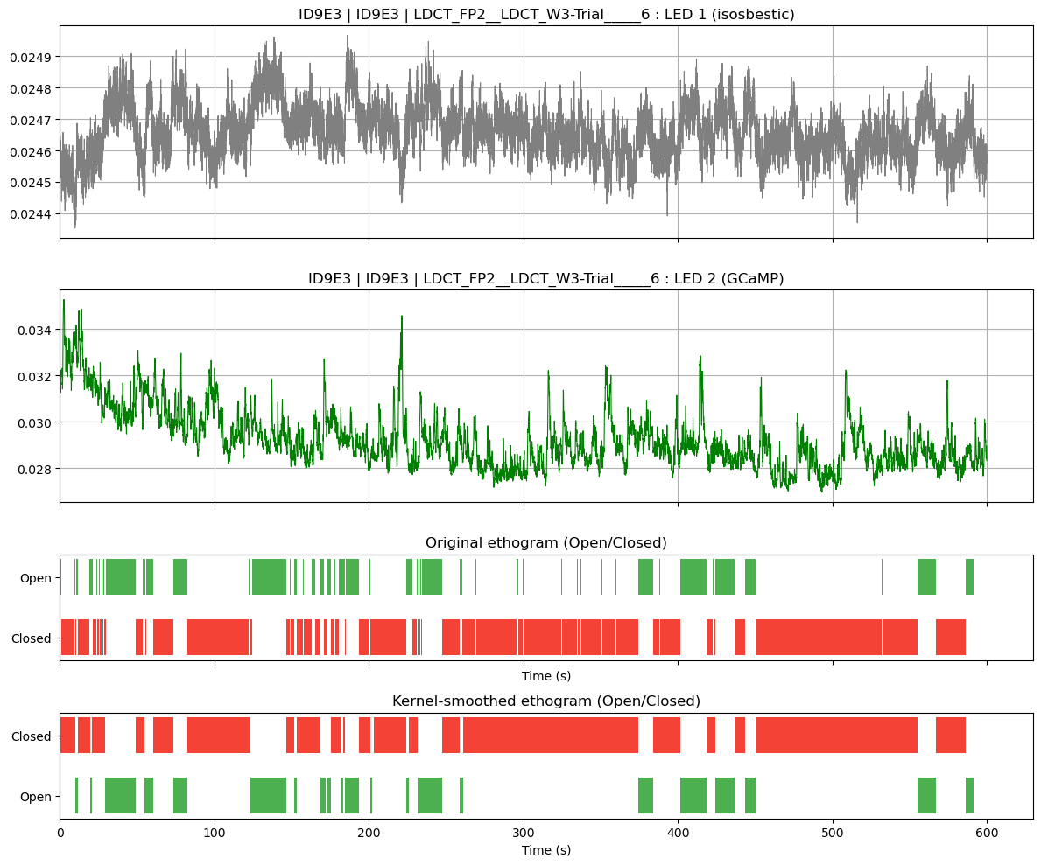
M372 W2 and W3 – goes from .04 in W2 to .028 in W3

Slide 7
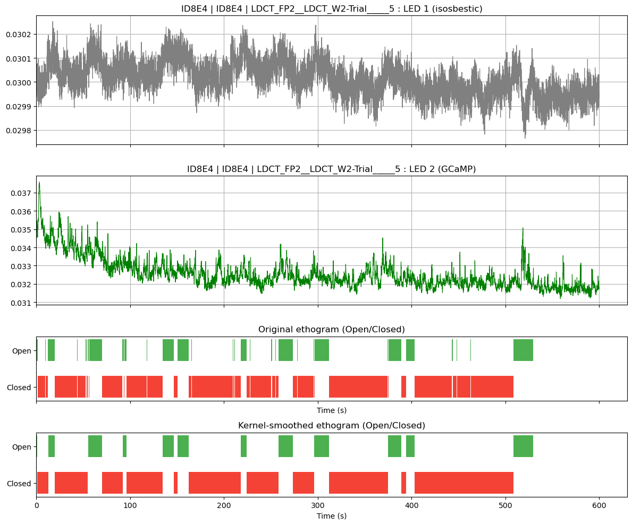
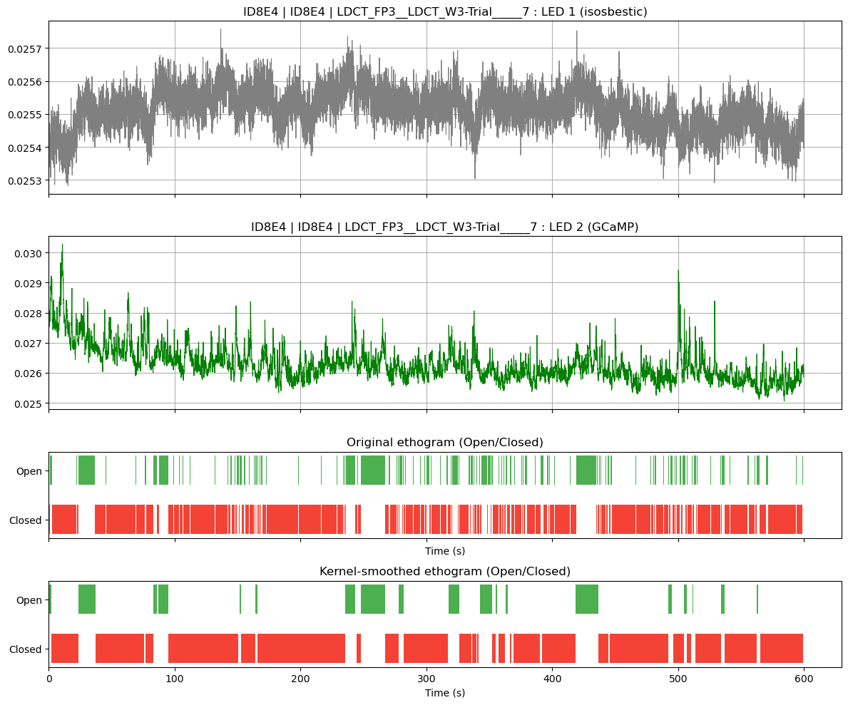
M374 W2 and W3 – goes from ~.032 in W2 to ~.026 in W3

Slide 8
Cohort 2
Isobestic and 470 intensities kept the same across the testing days – does it affect signal?
EPM left and 3CT right Preinduction week

Slide 9
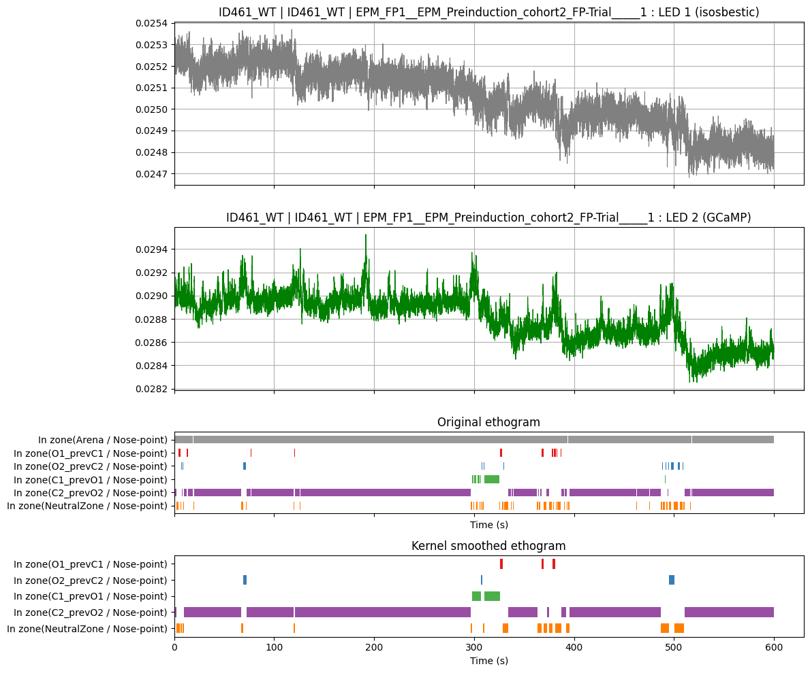
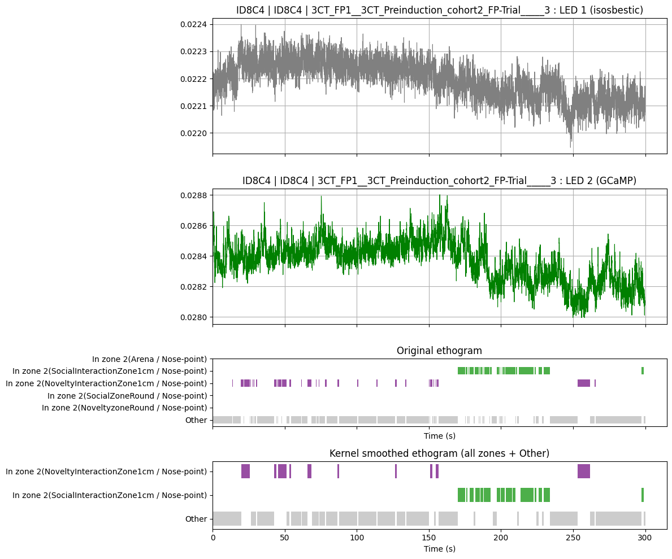
Cohort 2 EPM left and 3CT right M461

Slide 10
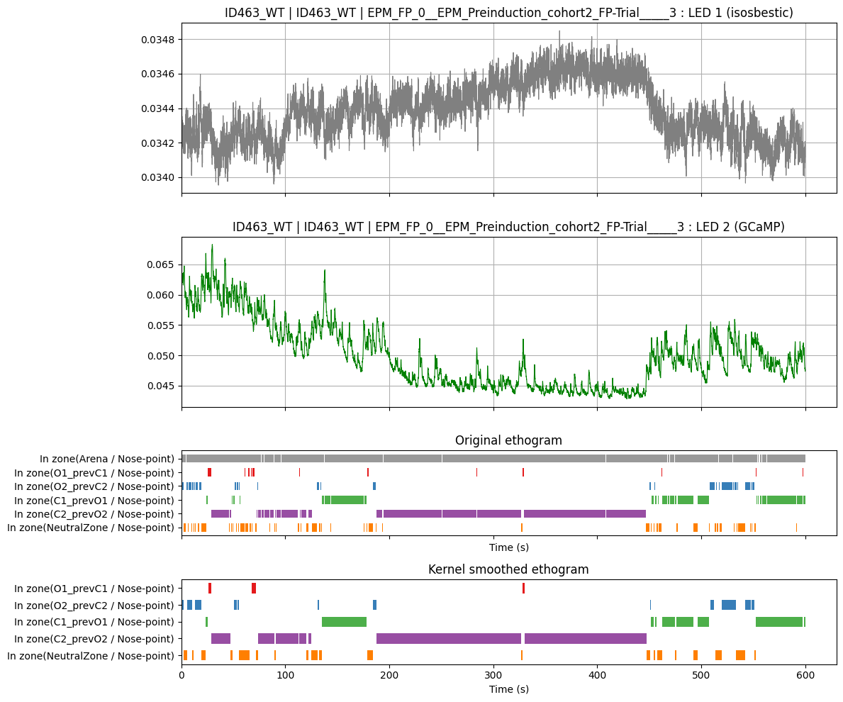
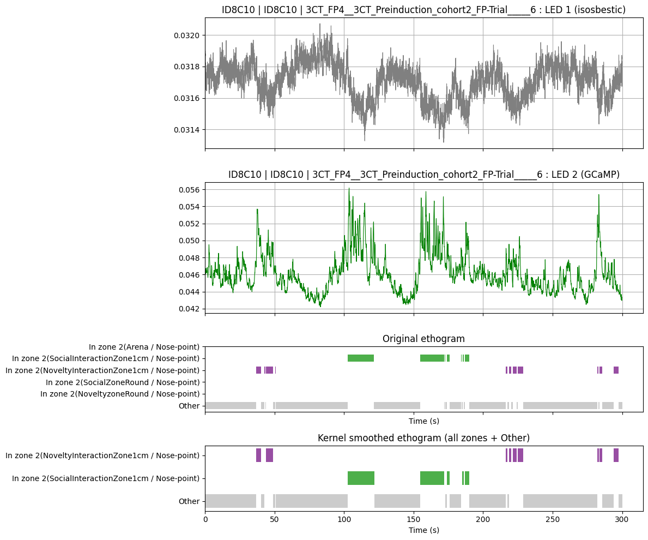
Cohort 2 EPM and 3ct M463

Slide 11
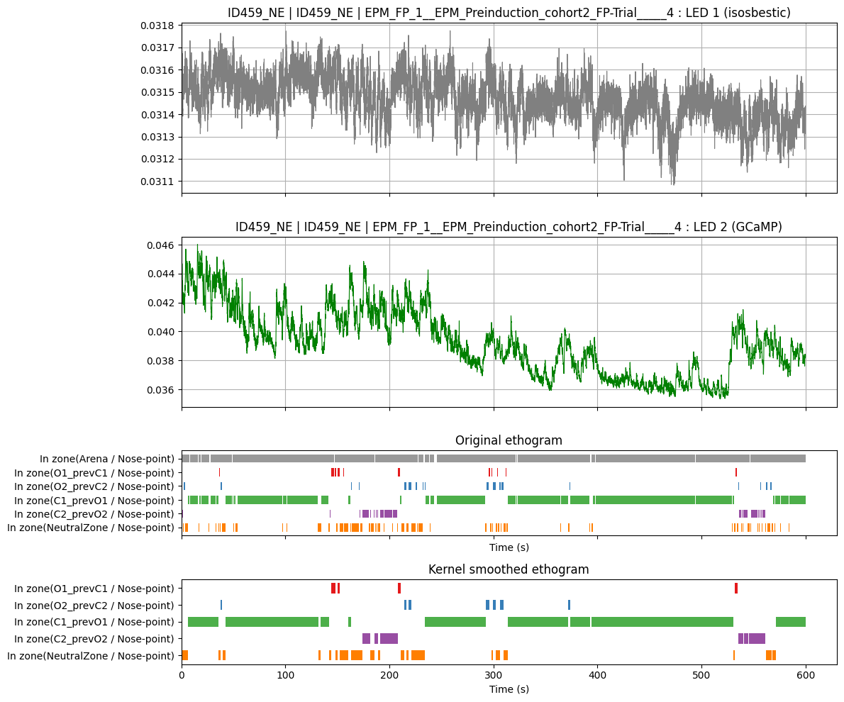
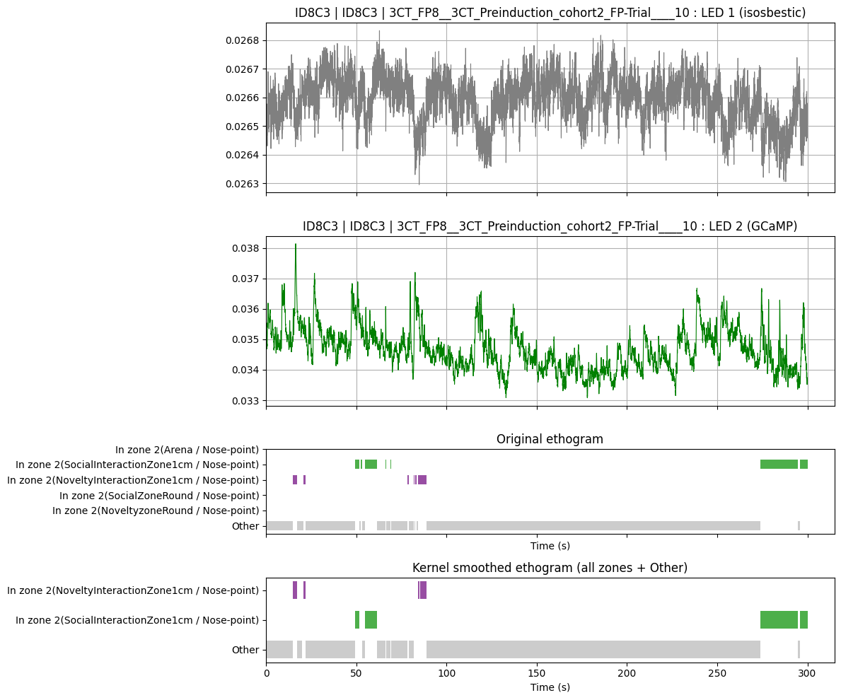
Cohort 2 EPM M459

Slide 12
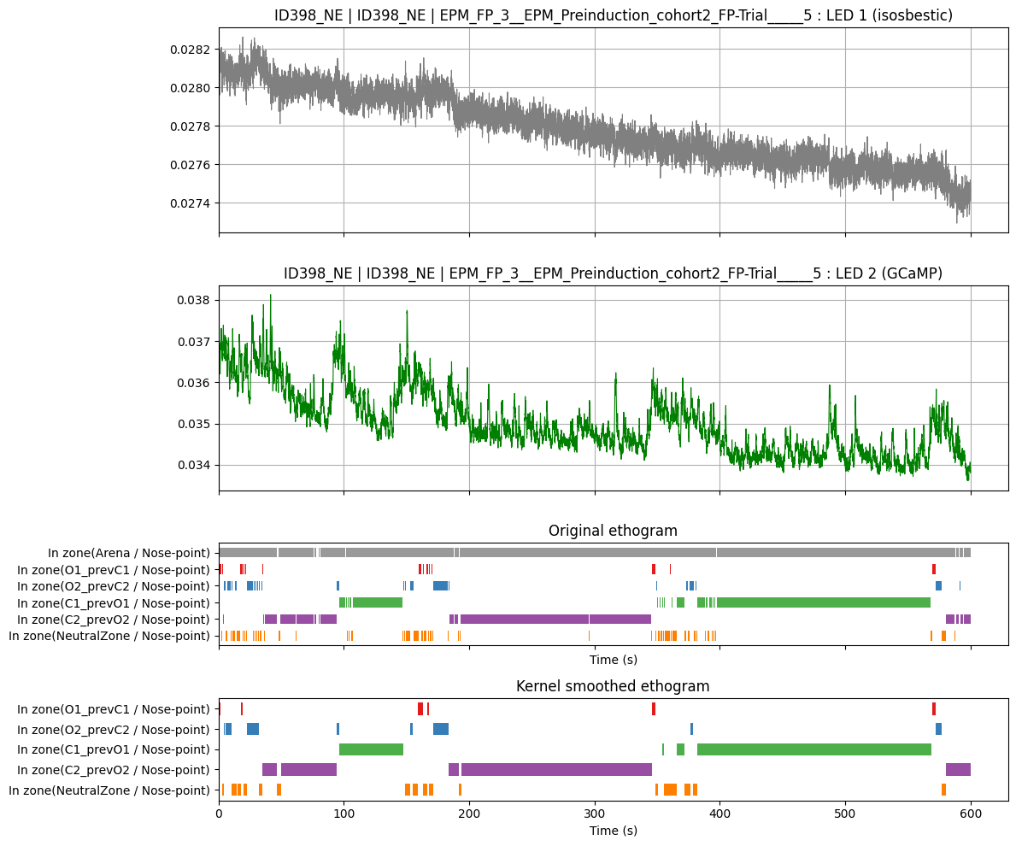
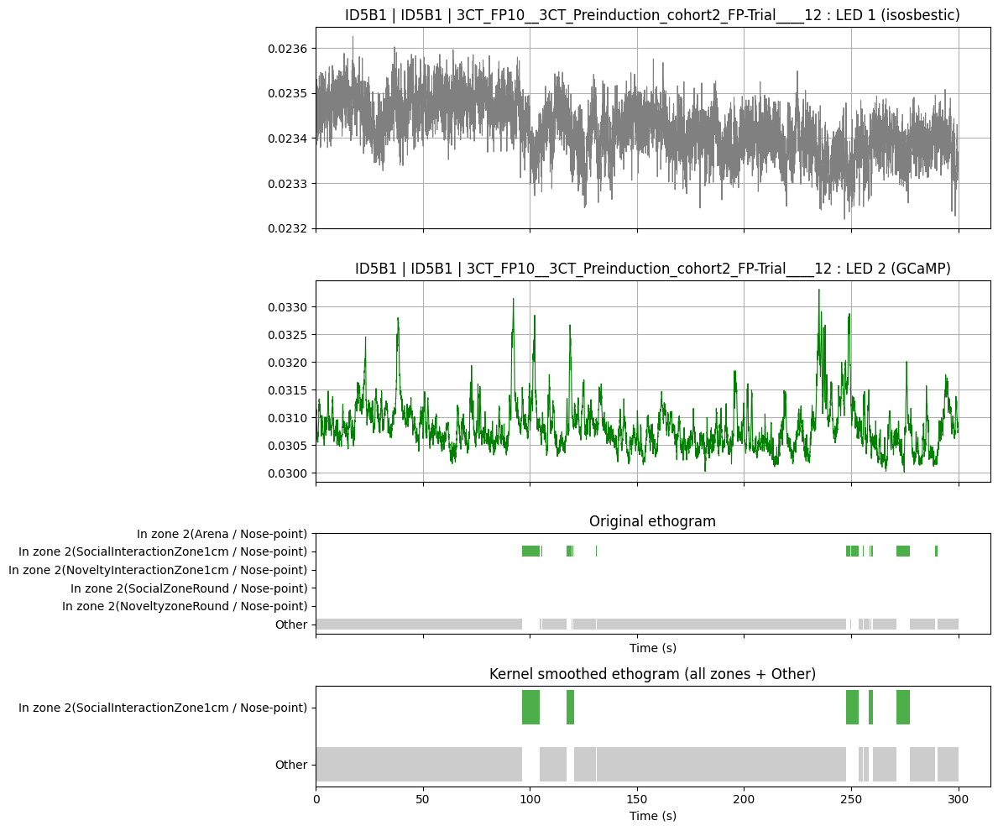
Cohort 2 EPM M398

Slide 13
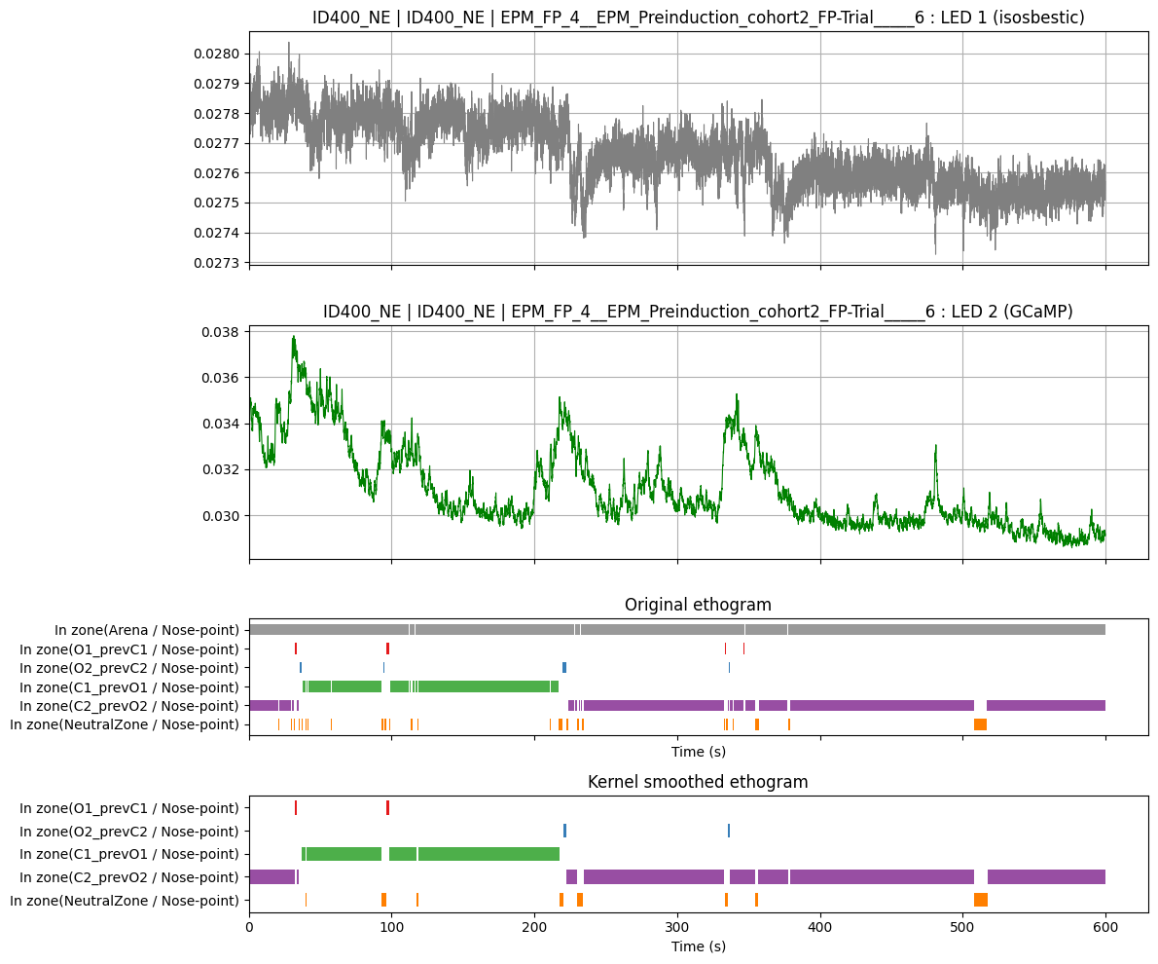
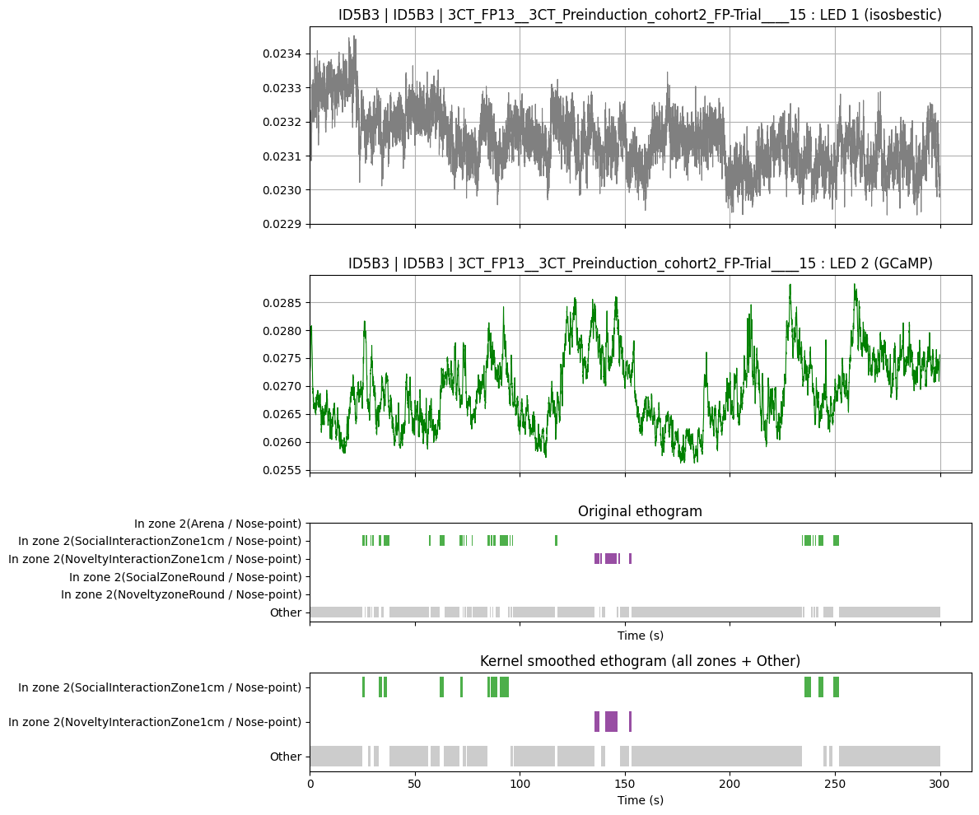
Cohort 2 EPM M400

Slide 14
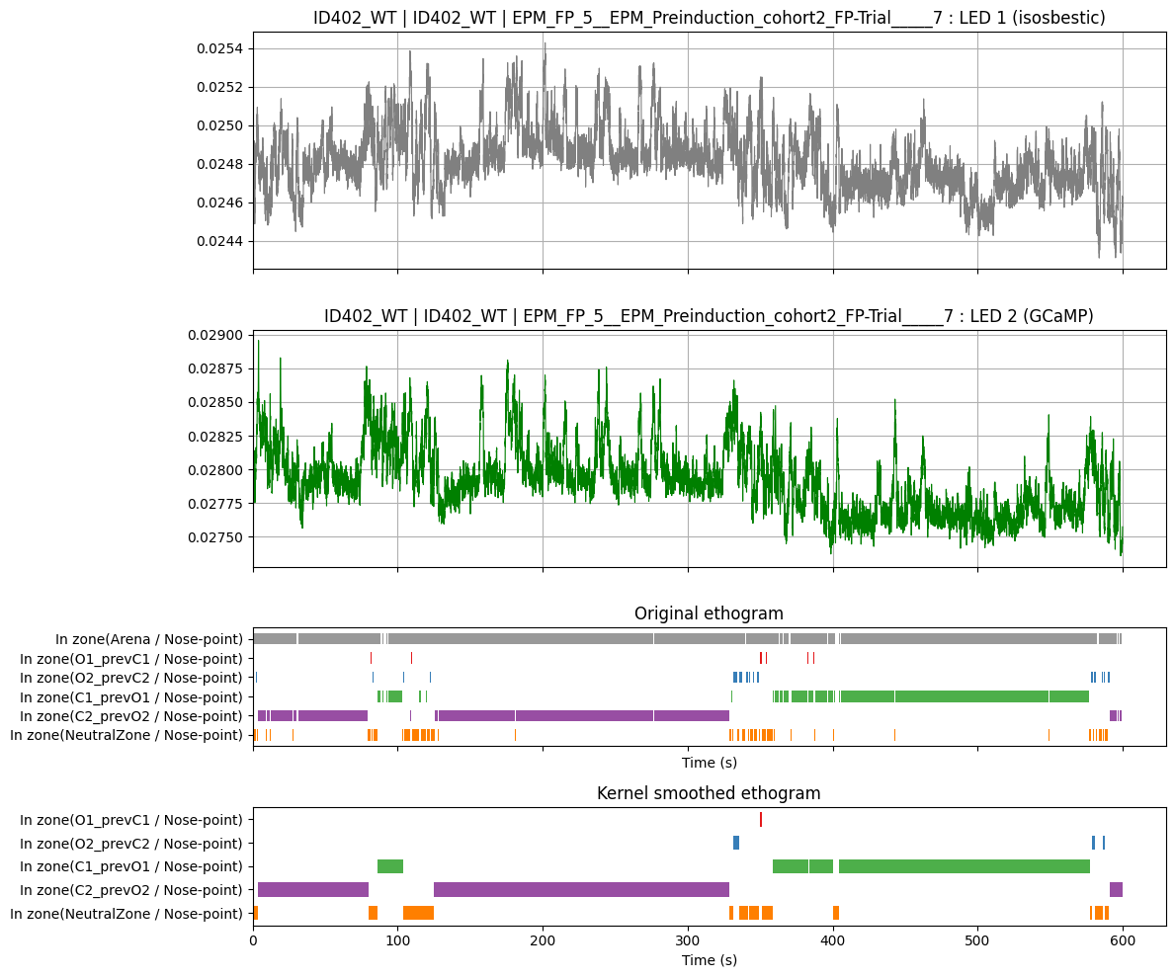
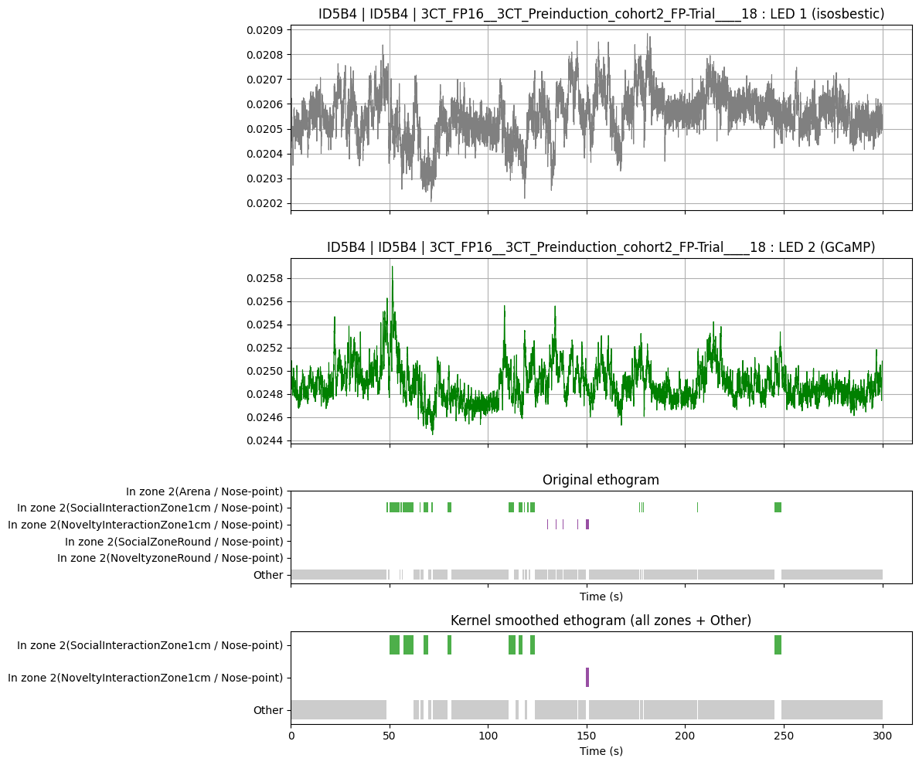
Cohort 2 EPM M402

